Slide 1
GTS WebSocket General Guide

Slide 2
Requirements for WebSocket
Internet Explorer 11
The Websocket will ONLY work with Internet Explorer 11, not lower.
Another document guiding through the installation of Internet Explorer 11 will be provided.
This should be done automatically for Intune-linked PCs.
GTS v. 11.30.014 or higher.
Older versions will NOT work. We strongly recommend keeping GTS updated to the latest version (12.30.017)
IMPORTANT

Slide 3
Installation

Slide 4
1. UNINSTALL Older WebSocket versions (any version <1.0.0.29) if present.
For Windows 7 via Control Panel
2
0. UNINSTALLING WEBSOCKET
3
1
4
5

Slide 5
1. UNINSTALL Older WebSocket versions (<1.0.0.29) if present.
For Windows 10 via Control Panel
2
4
0. UNINSTALLING WEBSOCKET
3
1 (Rightclick)

Slide 6
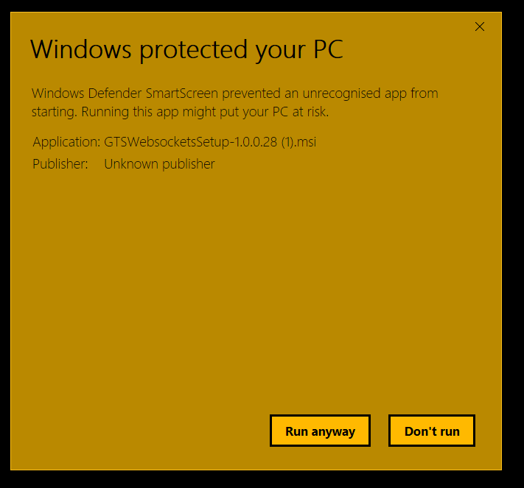
1. Download Websocket 1.0.0.29
Option 1: Click on following link: https://s3-eu-west-1.amazonaws.com/44020/techdoc3/WebSockets/Installer/WS29/GTSWebsocketsSetup1.0.0.29.2.msi
Option 2: Go to GTS Software page on TD3 for downloading the same version.
7
A download will start (in Chrome). Click on it.
You will be asked to save or run in IE11. Click on Save As and save somewhere accessible (such as desktop)
1. WEBSOCKET INSTALLATION
If a security warning pops up for this software (GTS Websocket 1.0.0.29), run it anyway.

Slide 7
2. Run executable
Accept the terms and click on Install
1. WEBSOCKET INSTALLATION

Slide 8
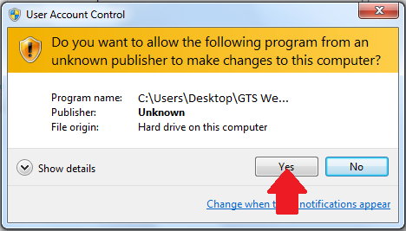
3. Actual installation
1. WEBSOCKET INSTALLATION
When the User Account Control window security warning pops up, select Yes
Wait for the installation to complete

Slide 9
4. Completing installation
1. WEBSOCKET INSTALLATION
Once that window disappears, a confirmation dialog will appear. Click Finish afterward.

Slide 10
Troubleshooting
Before elevating the case to the next support level, please make sure that you have performed all the verifications from the following slides.
The order of the verification is logic:
1. Check if application is installed
2. Check if the application by itself works correct
3. Check if the browser uses the Websockets plug-in
The slide 19 ( Internet Explorer settings) is the case most encountered so please make sure to apply the indicated settings and perform the vehicle connection again.
Respect the order of the steps, follow the instructions and you should quickly identify and fix your problem!

Slide 11
1. Verify if WebSocket 29 is installed
For Windows 7 via Control Panel
2
2. TROUBLESHOOTING
3
1
Look for
GTS Websocket 1.0.0.29.
If you can’t find it, then the software was not installed. Try again or contact IT.
4

Slide 12
1. Verify if WebSocket 29 is installed
For Windows 10 via Control Panel
2
2. TROUBLESHOOTING
3
Look for
GTS Websocket 1.0.0.29.
If you can’t find it, then the software was not installed. Try again or contact IT.
1 (Rightclick)

Slide 13
2. Verify if WebSocket is connected properly
For this, you need to run the SSLTest file. You can find it in: For 32-bit PC
C:\Program Files\Toyota Diagnostics\Techstream\bin\xela For 64-bit PC
C:\Program Files (x86)\Toyota Diagnostics\Techstream\bin\xela
2. TROUBLESHOOTING

Slide 14
2. Verify if WebSocket is connected properly
Right-click the SSLTest file and open it with Internet Explorer 11.
2. TROUBLESHOOTING

Slide 15
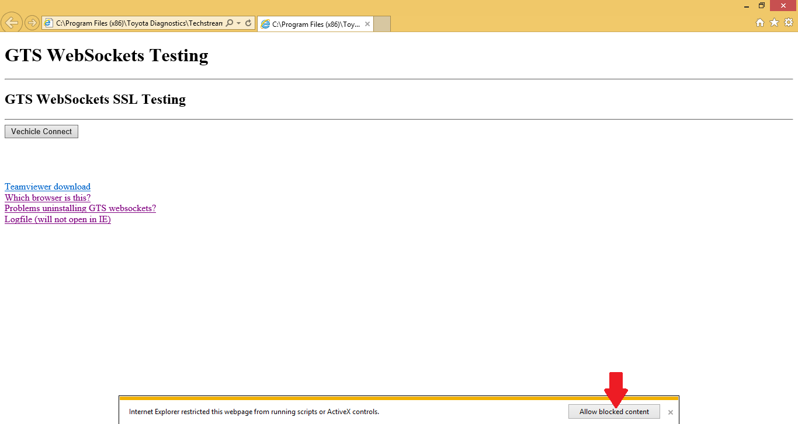
2. Verify if WebSocket is connected properly
If you see this security error, allow the blocked content. Otherwise, the page will not work.
2. TROUBLESHOOTING
Make sure you click this button when the message is displayed.

Slide 16
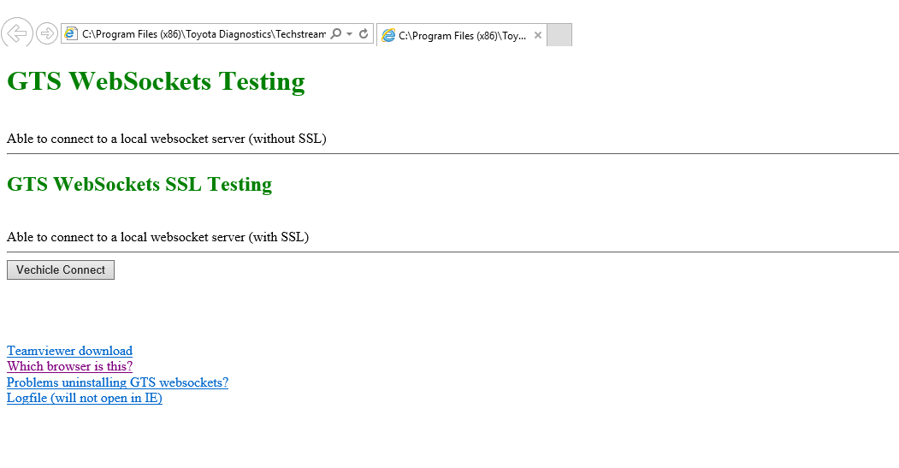
2. Verify if WebSocket is connected properly
If both GTS WebSockets Testing and GTS WebSockets SSL Testing turn green, then the certificates have been successfully installed. To verify if you can connect, click on the “Vehicle Connect” button. (Check VIM in TechStream)
Under correct behaviour both of these text lines need to be GREEN
2. TROUBLESHOOTING

Slide 17
2. Verify if WebSocket is connected properly
If it’s not the case, like below, try restarting your PC. If it’s still not OK, try to uninstall and re-install Websockets.
If the issue persists, then contact your IT department.
Green text line= OK condition
Red text line= NOK condition
2. TROUBLESHOOTING

Slide 18
3. Connectivity issues in NGTD
You may run into issues if you click on “Read VIN” button, because the WebSocket is not connected properly.
If you have checked everything else and you are able to connect to the vehicle with the SSLTest page, then the issue might be related to Internet Explorer settings.
2. TROUBLESHOOTING

Slide 19
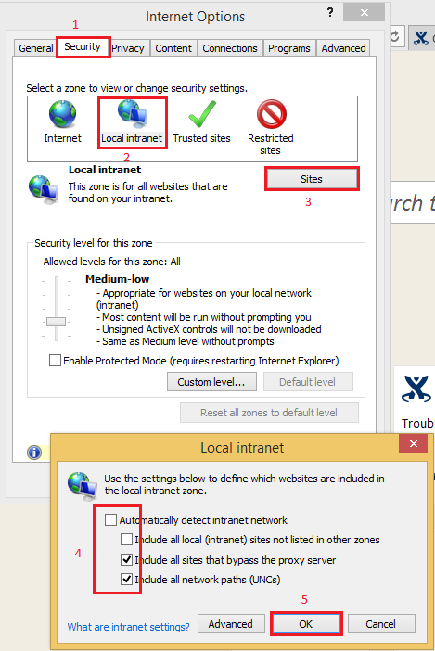
3. Connectivity issues in NGTD
Perform these steps to ensure that the WebSocket works properly. Please note: For PCs linked to Intune deployments, this should be done automatically. If you see this error, notify your IT team.
Important: If these settting are not correctly set up ( all boxes must be empty) the browser will not use under certain circumstances the Websockets plug in resulting in an impossibility of connecting to the vehicle via the New Techdoc portal
2. TROUBLESHOOTING
Make sure to UNCHECK (empty) all the boxes in this pop up and save the result (click OK).

Slide 20
Collecting communication logs
Important: Logs are mandatory for the situations when dealer requires support!

Slide 21
1. Tracer file location
If you encounter any issues during the usage of the WebSocket, e.g it crashed, then you may be asked to provide the logging (also known as tracer) file, called “GTSLogger”.
You can find that file here:
For 32-bit PC
C:\Program Files\Toyota Diagnostics\Techstream\bin\xela\gtswslogs For 64-bit PC
C:\Program Files (x86)\Toyota Diagnostics\Techstream\bin\xela\gtswslogs
3. TRACING FILE
Include every file you find in this folder with your error report.

